Slide 1
Systems, Roles, and Development Methodologies
1
Kendall & Kendall Systems Analysis and Design, 9e
Notes:
1

Slide 2
Learning Objectives
Understand the need for systems analysis and design in organizations.
Realize what the many roles of the systems analyst are.
Comprehend the fundamentals of three development methodologies:
SDLC
The agile approach
Object-oriented systems analysis and design

Slide 3
Information—A Key Resource
Fuels business and can be the critical factor in determining the success or failure of a business
Needs to be managed correctly
Managing computer-generated information differs from handling manually produced data
Notes:
Information is now considered a key resource and must be managed the same as any other key resource of an organization.
Decision makers now understand that information is not just a byproduct of doing business
Needs to be managed correctly. Costs are associated with the production, distribution, security, storage, and retrieval of all information. Its strategic use for positioning a business competitively should not be taken for granted.
With the availability of networked computers, along with access to the Internet and the WWW we are in the midst of an information explosion. The managing of computer-generated information rises issues with greater cost associated with organizing and maintaining and having users treat it less skeptically than information obtained in different ways.

Slide 4
Major Topics
Fundamentals of different kinds of information systems
Roles of systems analysts
Phases in the systems development life cycle as they relate to Human-Computer Interaction (HCI) factors
CASE tools
Open Source Software

Slide 5
Need for Systems Analysis and Design
Installing a system without proper planning leads to great user dissatisfaction and frequently causes the system to fall into disuse
Lends structure to the analysis and design of information systems
A series of processes systematically undertaken to improve a business through the use of computerized information systems
Notes:
User involvement throughout the systems project is critical to the successful development of computerized information systems.
New technologies are also driving the need for systems analysis. Ajax and Ruby on Rails are two examples.

Slide 6
Roles of the Systems Analyst
The analyst must be able to work with people of all descriptions and be experienced in working with computers
Three primary roles:
Consultant
Supporting expert
Agent of change
Notes:
The systems analyst systematically assesses how users interact with technology and business function by examining the inputting of information with the intent of improving organizational processes.
The analyst needs to play many roles, balancing several at the same time.
Consultant: Advantage—can bring with them a fresh perspective that other people in an organization do not possess.
Disadvantage—true organizational structure can never be known to an outsider.
Supporting expert: Draws on professional expertise concerning computer hardware and software and their uses in the business.
Serves as a resource for those who are working on and managing other projects
Agent of change: A person who serves as a catalyst for change, develops a plan for change, and works with others in facilitating that change.

Slide 7
Qualities of the Systems Analyst
Problem solver
Communicator
Strong personal and professional ethics
Self-disciplined and self-motivated
Notes:
The successful systems analyst must possess a wide range of qualities.
Problem solver—views the analysis of problems as a challenge and enjoys devising workable solutions.
Communicator—capable of relating meaningfully to other people over extended periods over time. Need enough computer experience to program, to understand the capabilities of computers, glean information requirements from users, and communicate what is needed to programmers.
Strong personal and professional ethics—need to shape their client relationships
Self-disciplined and self-motivated—must be able to coordinate other people as well as innumerable project resources.

Slide 8
Systems Development Life Cycle (SDLC)
The systems development life cycle is a phased approach to solving business problems
Developed through the use of a specific cycle of analyst and user activities
Each phase has unique user activities
Notes:
Analysts disagree on exactly how many phases there are in the SDLC.
Each phase consists of activities which overlap into other phases and then taper off, rather then done in separate steps.

Slide 9
The Seven Phases of the Systems Development Life Cycle (Figure 1.1)

Slide 10
Incorporating Human-Computer Interaction (HCI) Considerations
The demand for analysts who are capable of incorporating HCI into the systems development process keeps increasing, as companies begin to realize that the quality of systems and the quality of work life can be improved by taking a human-centered approach at the outset of a project
Notes:
HCI is that aspect of a computer that enables communications and interactions between human and computer. Implementing HCI into SDLC implies emphasizing people rather than the work to be done or the IT that is involved.
Adopting HCI principles examines a variety of user needs:
physical or ergonomic factors
usability factors
pleasing, aesthetic, and enjoyable aspects
behavioral aspects
HCI can be thought of as a human-centered approach that puts people ahead of organizational structure

Slide 11
Identifying Problems, Opportunities, and Objectives
Activity:
Interviewing user management
Summarizing the knowledge obtained
Estimating the scope of the project
Documenting the results
Notes:
Critical to the success of the rest of the project, because no one wants to waste time addressing the wrong problem.
Problems—generally the reason the analyst was called in in the first place.
Opportunities—situations that the analyst believes can be improved through the use of computerized information systems.
Objectives—how can the business reach its objectives by addressing specific problems or opportunities.

Slide 12
Identifying Problems, Opportunities, and Objectives
Output:
Feasibility report containing problem definition and objective summaries from which management can make a decision on whether to proceed with the proposed project
Notes:
Critical to the success of the rest of the project, because no one wants to waste time addressing the wrong problem.
Problems—generally the reason the analyst was called in in the first place.
Opportunities—situations that the analyst believes can be improved through the use of computerized information systems.
Objectives—how can the business reach its objectives by addressing specific problems or opportunities.

Slide 13
Determining Human Information Requirements
Activity:
Interviewing
Sampling and investing hard data
Questionnaires
Observe the decision maker’s behavior and environment
Prototyping
Learn the who, what, where, when, how, and why of the current system
Notes:
Determining human needs of the users involved.
Uses activities to pose and answer questions concerning human-computer interaction:
What are the users strengths and limitations?
Trying to understand what information users need to perform their jobs.
Who—the people who are involved
What—the business activity
Where—the environment in which the work takes place
When—the timing
How—how the current procedures are performed
Why—why the system uses the current system

Slide 14
Determining Human Information Requirements
Output:
The analyst understands how users accomplish their work when interacting with a computer
Begin to know how to make the new system more useful and usable
Know the business functions
Have complete information on the:
People
Goals
Data
Procedure involved
Notes:
Determining human needs of the users involved.
Uses activities to pose and answer questions concerning human-computer interaction:
What are the users strengths and limitations?
Trying to understand what information users need to perform their jobs.
Who—the people who are involved
What—the business activity
Where—the environment in which the work takes place
When—the timing
How—how the current procedures are performed
Why—why the system uses the current system

Slide 15
Analyzing System Needs
Activity:
Create data flow, activity, or sequence diagrams
Complete the data dictionary
Analyze the structured decisions made
Prepare and present the system proposal
Output:
Recommendation on what, if anything, should be done
Notes:
Data flow diagrams—chart the input, processes, and output of the business’s functions in a structured graphical form.
Data dictionary—lists all the data items used in the system, as well as their specifications.
Structured decisions made—those for which the conditions, condition alternatives, actions, and action rules can be determined.
Structure decision methods:
structures English
decision tables
decision trees
System proposal—summarizes what has been found
about users
usability and usefulness of current system
provides cost/benefit analysis of alternatives
makes recommendations on what (if anything) should be done
The recommendation or solution is based on the analysts individual qualities and professional training and their interaction with users.

Slide 16
Designing the Recommended System
Activity:
Design procedures for data entry
Design the human-computer interface
Design system controls
Design database and/or files
Design backup procedures
Output
Model of the actual system
Notes:
Uses the information collected earlier to accomplish the logical design of the information system:
designs procedures for users to help them accurately enter data
provides for users to complete effective input to the information system
devises the human-computer interface
designs files or databases that will store the data needed by decision makers
designs output (onscreen or printed)
designs controls and backup procedures

Slide 17
Developing and Documenting Software
Activity:
System analyst works with programmers to develop any original software
Works with users to develop effective documentation
Programmers design, code, and remove syntactical errors from computer programs
Document software with help files, procedure manuals, and Web sites with Frequently Asked Questions
Notes:
The analyst uses structure charts and pseudocode to communicate to the programmer what needs to be programmed.
Documentation includes:
procedure manuals
online help
websites
“Read Me” files
Because users are involved from the beginning, the documentation should address the questions they have raised and solved jointly with the analyst.

Slide 18
Developing and Documenting Software
Output:
Computer programs
System documentation
Notes:
The analyst uses structure charts and pseudocode to communicate to the programmer what needs to be programmed.
Documentation includes:
procedure manuals
online help
websites
“Read Me” files
Because users are involved from the beginning, the documentation should address the questions they have raised and solved jointly with the analyst.

Slide 19
Testing and Maintaining the System
Activity:
Test the information system
System maintenance
Maintenance documentation
Output:
Problems, if any
Updated programs
Documentation
Notes:
Testing should take place first with sample data and then with actual data.
Testing is done by both the programmers and the analyst.
The maintenance started here is carried out routinely through the life of the system.
updates may be performed via a vendor site on the Web.

Slide 20
Implementing and Evaluating the System
Activity:
Train users
Analyst plans smooth conversion from old system to new system
Review and evaluate system
Output:
Trained personnel
Installed system
Notes:
Training users to handle the system.
System conversion—converting files from old formats to new ones, or building a database, installing equipment, and bringing the new system into production.
Actual evaluation takes place during every phase.

Slide 21
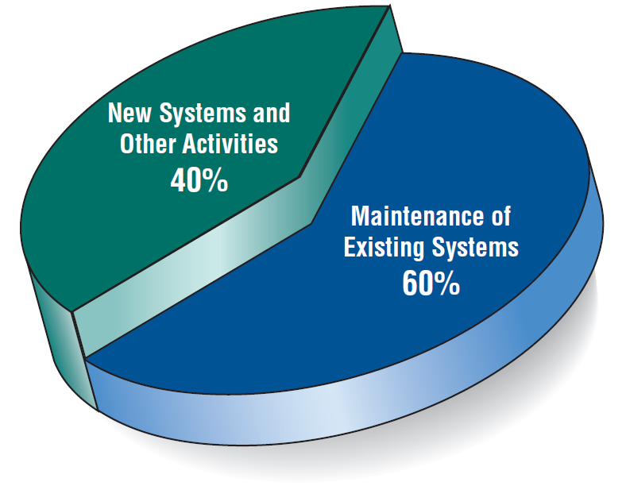
Some Researchers Estimate that the Amount of Time Spent on Systems Maintenance May Be as Much as 60 Percent of the Total Time Spent on Systems Projects (Figure 1.2)

Slide 22
The Impact of Maintenance
Maintenance is performed for two reasons:
Removing software errors
Enhancing existing software
Over time the cost of continued maintenance will be greater than that of creating an entirely new system. At that point it becomes more feasible to perform a new systems study.
Notes:
Computer programs must be modified and kept up to date.
Reasons for enhancing existing software:
users request additional features
business changes over time
hardware and software change

Slide 23
Resource Consumption over the System Life (Figure 1.3)
Notes:
Area under the curve represents the total dollar amount.
Eventually maintenance exceeds the cost of a creating a new system. At that point a new systems study should be untaken.

Slide 24
Approaches to Structured Analysis and Design and to the Systems Development Life Cycle
Traditional systems development life cycle
CASE systems development life cycle
Object-oriented systems analysis and design

Slide 25
Case Tools
CASE tools are productivity tools for systems analysts that have been created explicitly to improve their routine work through the use of automated support
Notes:
Increasing analyst productivity:
automates the drawing and modifying of diagrams
automates the sharing of work thus reducing the time to collaborate with group members
facilitates interaction among team members by making diagramming a dynamic, interactive process
Improving analyst-user communication—CASE tools foster greater, more meaningful communication among users and analysts.
Integrating life cycle activities—integration of activities through the underlying use of technologies makes it easier for users to understand how all the life cycle phases are interrelated and interdependent.
Accurately assessing maintenance changes—enable users to analyze and assess the impact of maintenance changes.

Slide 26
Reasons for Using Case Tools
Reasons for using CASE tools
Increasing analyst productivity
Improving analyst-user communication
Integrating life cycle activities
Notes:
Increasing analyst productivity:
automates the drawing and modifying of diagrams
automates the sharing of work thus reducing the time to collaborate with group members
facilitates interaction among team members by making diagramming a dynamic, interactive process
Improving analyst-user communication—CASE tools foster greater, more meaningful communication among users and analysts.
Integrating life cycle activities—integration of activities through the underlying use of technologies makes it easier for users to understand how all the life cycle phases are interrelated and interdependent.
Accurately assessing maintenance changes—enable users to analyze and assess the impact of maintenance changes.

Slide 27
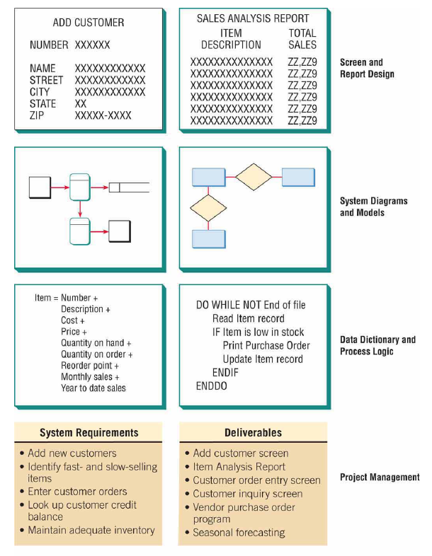

Slide 28
The Agile Approach
Based on:
Values
Principles
Core practices

Slide 29
Agile Values
Communication
Simplicity
Feedback
Courage

Slide 30
Four Agile Resources
Resources are adjusted to ensure successful project completion
Time
Cost
Quality
Scope

Slide 31
Five Stages of Agile Development
Exploration
Planning
Iterations to the first release
Productionizing
Maintenance

Slide 32
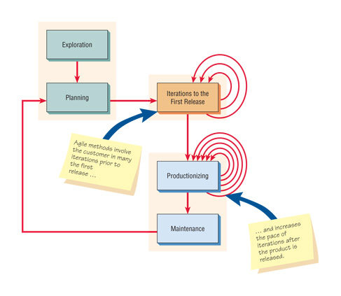
Agile Project Development Process (Figure 1.5)

Slide 33
Object-Oriented (O-O) Systems Analysis and Design
Alternate approach to the structured approach of the SDLC that is intended to facilitate the development of systems that change rapidly in response to dynamic business environments
Analysis is performed on a small part of the system followed by design and implementation
Notes:
Generally, works well in situations where complicated information systems are undergoing continuous maintenance, adaptation, and redesign.

Slide 34
Object-Oriented (O-O) Systems Analysis and Design
The cycle repeats with analysis, design, and implementation of the next part and this repeats until the project is complete
Examines the objects of a system
Notes:
Generally, works well in situations where complicated information systems are undergoing continuous maintenance, adaptation, and redesign.

Slide 35
Unified Modeling Language (UML) Phases
Define the use case model:
Use case diagram
Use case scenarios
Create UML diagrams
Develop class diagrams
Draw statechart diagrams
Modify the UML diagrams
Develop and document the system

Slide 36
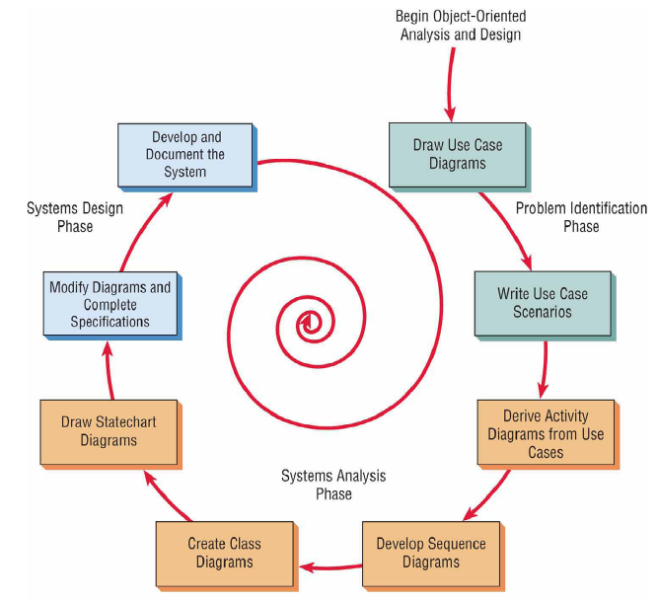

Slide 37
Choosing a Method
Choose either:
SDLC
Agile
Object-oriented methodologies

Slide 38
When to Use SDLC
Systems have been developed and documented using SLDC
It is important to document each step
Upper level management feels more comfortable or safe using SDLC
There are adequate resources and time to complete the full SDLC
Communication of how new systems work is important

Slide 39
When to Use Agile
There is a project champion of agile methods in the organization
Applications need to be developed quickly in response to a dynamic environment
A rescue takes place (the system failed and there is no time to figure out what went wrong)
The customer is satisfied with incremental improvements
Executives and analysts agree with the principles of agile methodologies

Slide 40
When to Use Object-Oriented
The problems modeled lend themselves to classes
An organization supports the UML learning
Systems can be added gradually, one subsystem at a time
Reuse of previously written software is a possibility
It is acceptable to tackle the difficult problems first

Slide 41
Open Source Software
An alternative of traditional software development where proprietary code is hidden from the users
Open source software is free to distribute, share, and modify
Characterized as a philosophy rather than simply the process of creating new software
Examples: Linux Operating System, Apache Web Server, Mozilla Firefox
Notes:
A movement to create, distribute, share and modify software which is not proprietary.
It’s not a monolithic movement instead it has been categorized into four community types:
ad hoc
standardized
organized
commercial
The four communities in turn differ from each other on six key dimensions:
general structure
environment
goals
methods
user community
licensing

Slide 42
Four Types of Open Source Communities:
Ad hoc
Standardized
Organized
Commercial

Slide 43
Six Key Dimensions that Differentiate Open Source Communities
General structure
Environment
Goals
Methods
User community
Licensing

Slide 44
Reasons for Participating in Open Source Communities
Rapidity with which new software can be developed and tested
Faster to have a committed group of experts develop, test, and debug code
This fosters creativity
Have many good minds work with innovative applications

Slide 45
Reasons for Participating in Open Source Communities
Potential to reduce development costs
Bolster their self-image
Contribute something worthwhile to the software development community

Slide 46
Open Source Contribution and Differentiation
Contributions to the open community and differentiation from the open community are for the following reasons:
Cost
Managing resources
Time it takes to bring a new product to the market

Slide 47
Reasons for Analyst Participation in the Open Source Community
Curiosity about software benefits
Achieve collective design
Incorporate open source software design into:
Proprietary products
Processes
Knowledge
IT artifacts

Slide 48
Collective Design
Through a process of collective design the IT artifact is imbued with
Community and organizational structures
Knowledge
Practices

Slide 49
Summary
Information is a key resource
Integration of traditional systems with new technologies
Roles and qualities of the systems analyst
The systems development life cycle
CASE tools
Agile systems development
Object-oriented systems development
Open source systems

Slide 50

Copyright © 2014 Pearson Education, Inc.
Publishing as Prentice Hall

